Slide 1
Chapter 2
Evolution of the Major Programming Languages

Slide 2
Chapter 2 Topics
Zuse’s Plankalkül
Minimal Hardware Programming: Pseudocodes
The IBM 704 and Fortran
Functional Programming: Lisp
The First Step Toward Sophistication: ALGOL 60
Computerizing Business Records: COBOL
The Beginnings of Timesharing: Basic
Copyright © 2017 Pearson Education, Ltd. All rights reserved.
1-<number>

Slide 3
Chapter 2 Topics (continued)
Everything for Everybody: PL/I
Two Early Dynamic Languages: APL and SNOBOL
The Beginnings of Data Abstraction: SIMULA 67
Orthogonal Design: ALGOL 68
Some Early Descendants of the ALGOLs
Programming Based on Logic: Prolog
History's Largest Design Effort: Ada
Copyright © 2017 Pearson Education, Ltd. All rights reserved.
1-<number>

Slide 4
Chapter 2 Topics (continued)
Object-Oriented Programming: Smalltalk
Combining Imperative ad Object-Oriented Features: C++
An Imperative-Based Object-Oriented Language: Java
Scripting Languages
The Flagship .NET Language: C#
Markup/Programming Hybrid Languages
Copyright © 2017 Pearson Education, Ltd. All rights reserved.
1-<number>

Slide 5
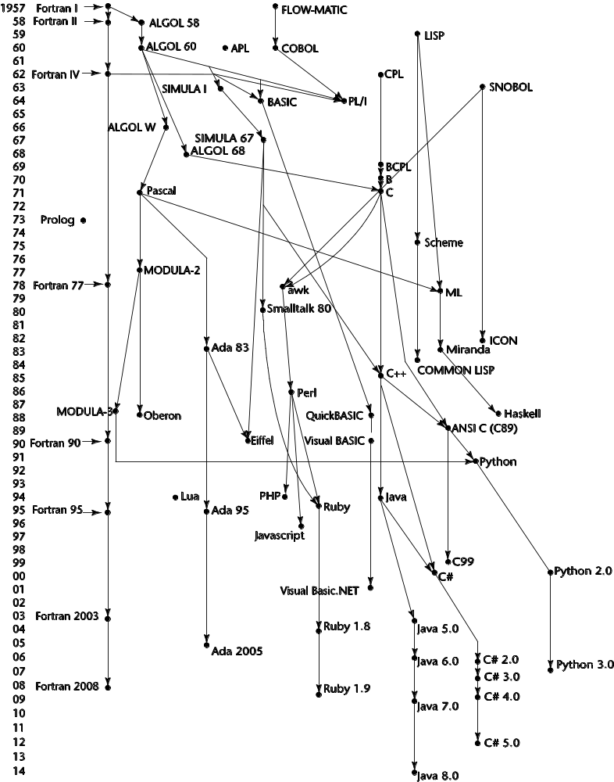
Genealogy of Common Languages
Copyright © 2017 Pearson Education, Ltd. All rights reserved.
1-<number>

Slide 6
Zuse’s Plankalkül
Designed in 1945
  but its description not published until 1972
Never implemented
Plankalkül→Program Calculus
Simple data type → bit
  Int and floating-point → from bit type
Arrays, records (struct in C)
  The records may include nested records
Fin command
  Specifies an exit out of a given number of iteration loop nestings or to the
  beginning of a new iteration cycle.
Copyright © 2017 Pearson Education, Ltd. All rights reserved.
1-<number>

Slide 7
Zuse’s Plankalkül
Selection statement
  Not allow “else”
Each statement consisted of either two or three lines of code.
  First line → most like the statements of current languages.
  Second line (opt.) → contains the subscripts of the array references in the first line.
  Last line → contains the type names for the variables mentioned in the first line.
Copyright © 2017 Pearson Education, Ltd. All rights reserved.
1-<number>

Slide 8
Plankalkül Syntax
An assignment statement to assign the expression A[4] + 1 to A[5]
| A + 1 => A
V | 4 5 (subscripts)
S | 1.n 1.n (data types)
1.n → means an integer of n bits:
Copyright © 2017 Pearson Education, Ltd. All rights reserved.
1-<number>

Slide 9
Minimal Hardware Programming: Pseudocodes
In the late 1940s and early 1950s
  No high-level PLs
  Even assembly languages
  Programming in machine code
    Tedious, error-prone
    numeric codes for specifying instructions
      ADD → 14
      Difficult to read!
  primary motivations for inventing assemblers and assembly languages
Copyright © 2017 Pearson Education, Ltd. All rights reserved.
1-<number>

Slide 10
Pseudocodes: Short Code
Short Code developed by Mauchly in 1949 for BINAC computers
Short Code was later transferred to a UNIVAC I computer (the first commercial electronic computer sold in the United States)
  Expressions were coded, left to right
  Example of operations:
01 – 06 abs value 1n (n+2)nd power
02 ) 07 + 2n (n+2)nd root
03 = 08 pause 4n if <= n
04 / 09 ( 58 print and tab
Copyright © 2017 Pearson Education, Ltd. All rights reserved.
1-<number>

Slide 11
Pseudocodes: Short Code
For example, X0 and Y0 could be variables. The statement
  X0 = SQRT(ABS(Y0))
  Coded as 00 X0 03 20 06 Y0
  00 → padding 03 → = 20 → SQRT 06 → ABS
not translated to machine code
implemented with a pure interpreter
  automatic programming
50 times slower than machine code!
Copyright © 2017 Pearson Education, Ltd. All rights reserved.
1-<number>

Slide 12
Pseudocodes: Speedcoding
Speedcoding developed by Backus in 1954 for IBM 701
  Interpreter
  pseudoinstructions for the four arithmetic operations on floating-point data
  operations such as square root, sine, arc tangent, exponent, and logarithm
  After loading the interpreter, the remaining usable memory was 700 words!
Copyright © 2017 Pearson Education, Ltd. All rights reserved.
1-<number>

Slide 13
Pseudocodes: Related Systems
The UNIVAC “Compiling” System
  Developed by a team led by Grace Hopper
  Pseudocode expanded into machine code subprograms
  Great improvement → because it made source programs much shorter
David J. Wheeler (Cambridge University)
  developed a method of using blocks of re-locatable addresses to solve the problem of absolute addressing (direct/exact memory address utilized by hardware devices or software programs)
Copyright © 2017 Pearson Education, Ltd. All rights reserved.
1-<number>

Slide 14
IBM 704 and Fortran
Fortran 0: 1954 - not implemented
Fortran I:1957
  Designed for the new IBM 704, which had index registers and floating-point hardware
  - This led to the idea of compiled programming languages, because there was no place to hide the cost of interpretation (no floating-point software)
Copyright © 2017 Pearson Education, Ltd. All rights reserved.
1-<number>

Slide 15
Design Process of Fortran
FORTRAN → The IBM Mathematical FORmula TRANslating System:
The environment in which Fortran was developed:
  Computers→small mem., slow & unreliable
  Primary use → Sci. computations
  no existing efficient and effective ways to program computers
  High cost
Copyright © 2017 Pearson Education, Ltd. All rights reserved.
1-<number>

Slide 16
Fortran I Overview
First implemented version of Fortran
  Variable names could have up to six characters
  Post-test counting loop (DO) statement
  I/O formatting
  User-defined subprograms
  Three-way selection statement (arithmetic IF)
  No data typing statements
    Variables whose names began with I, J, K, L, M, and N were implicitly integer type
    Others → floating-point
Copyright © 2017 Pearson Education, Ltd. All rights reserved.
1-<number>

Slide 17
Fortran I Overview (continued)
First implemented version of FORTRAN
  Compiler released in April 1957, after 18 worker-years of effort
  Programs larger than 400 lines rarely compiled correctly, mainly due to poor reliability of 704
  Code was very fast
  Quickly became widely used
Copyright © 2017 Pearson Education, Ltd. All rights reserved.
1-<number>

Slide 18
Fortran II
Distributed in 1958
  Independent compilation
  Fixed the bugs in Fortran I
the most important feature → the independent compilation of subroutines.
Without independent compilation, any change in a program required that the entire program be recompiled.
Copyright © 2017 Pearson Education, Ltd. All rights reserved.
1-<number>

Slide 19
Fortran IV
Evolved during 1960-62
  Explicit type declarations for vars.
  Logical selection statement (If)
  Subprogram names could be parameters
    the capability of passing subprograms as parameters to other subprograms
  ANSI standard in 1966
Copyright © 2017 Pearson Education, Ltd. All rights reserved.
1-<number>

Slide 20
Fortran 77
Became the new standard in 1978
  Character string handling
  Logical loop control statements
  IF-THEN-ELSE statement
Copyright © 2017 Pearson Education, Ltd. All rights reserved.
1-<number>

Slide 21
Fortran 90
Most significant changes from Fortran 77
  Dynamic arrays
  Records
  Pointers
  Multiple selection statement
  Modules
  Recursion (subprograms could be called recursively)
Copyright © 2017 Pearson Education, Ltd. All rights reserved.
1-<number>

Slide 22
Latest versions of Fortran
Fortran 95 – relatively minor additions, plus some deletions
Fortran 2003 – support for OOP, procedure pointers, interoperability with C
Fortran 2008 – blocks for local scopes, co-arrays which provide a parallel execution model, “Do Concurrent” construct → specify loops without interdependencies
Copyright © 2017 Pearson Education, Ltd. All rights reserved.
1-<number>

Slide 23
Fortran Evaluation
Allows Highly optimizing compilers (all versions before 90)
  Types and storage of all variables are fixed before run time
  No new variables or space could be allocated during execution time.
Dramatically changed the way computers are used
Copyright © 2017 Pearson Education, Ltd. All rights reserved.
1-<number>

Slide 24
Functional Programming: Lisp
LISt Processing language
  Designed at MIT by McCarthy
  The first functional programming language!
AI research needed a language to
  Process data in lists (rather than arrays)
  Symbolic computation (rather than numeric)
Only two data types: atoms (symbols, numeric literals) and lists
Copyright © 2017 Pearson Education, Ltd. All rights reserved.
1-<number>

Slide 25
Functional Programming: Lisp
Lists are specified by delimiting their elements with parentheses. Simple lists, in which elements are restricted to atoms, have the form:
  (A B C D)
Nested list structures are also specified by parentheses:
  (A (B C) D (E (F G))
  composed of four elements. The first is the atom A; the second is the sublist
  (B C);
  the third is the atom D; the fourth is the sublist (E (F G)), which has
  as its second element the sublist (F G).
Copyright © 2017 Pearson Education, Ltd. All rights reserved.
1-<number>

Slide 26
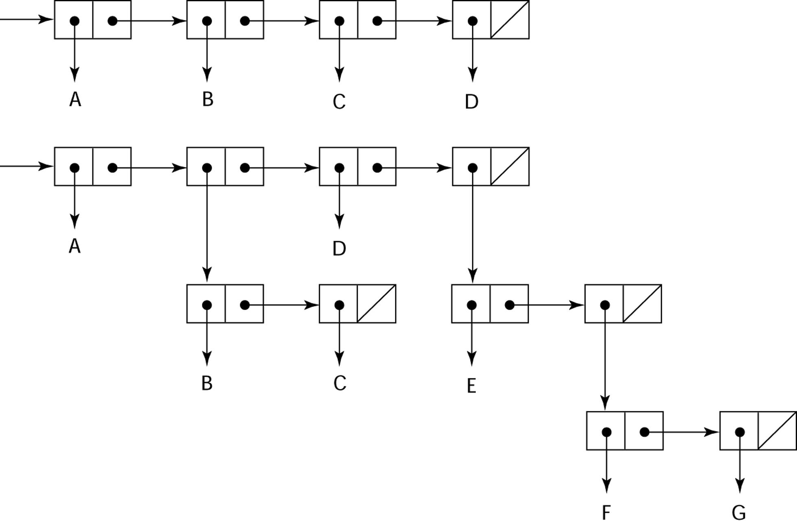
Representation of Two Lisp Lists
Representing the lists (A B C D)
and (A (B C) D (E (F G)))
Copyright © 2017 Pearson Education, Ltd. All rights reserved.
1-<number>

Slide 27
Lisp Evaluation
Pioneered functional programming
  No need for variables or assignment
  Control is provided via recursion and conditional expressions
Still the dominant language for AI
Common Lisp and Scheme are contemporary dialects of Lisp
ML, Haskell, and F# are also functional programming languages, but use very different syntax
Copyright © 2017 Pearson Education, Ltd. All rights reserved.
1-<number>

Slide 28
Scheme
Developed at MIT in mid 1970s
Characterized by:
  Small size
  Extensive use of static scoping
  Functions as first-class entities
  Functions can be assigned to vars, passed as params.
Simple syntax (and small size) make it ideal for educational applications
Copyright © 2017 Pearson Education, Ltd. All rights reserved.
1-<number>

Slide 29
Common Lisp
An effort to combine features of several dialects of Lisp into a single language
Large, complex, used in industry for some large applications
Copyright © 2017 Pearson Education, Ltd. All rights reserved.
1-<number>

Slide 30
The First Step Toward Sophistication: ALGOL 60
Environment of development
  FORTRAN had (barely) arrived for IBM 70x
  Many other languages were being developed, all for specific machines
  No portable language; all were machine- dependent
  No universal language for communicating algorithms
ALGOL 60 was the result of efforts to design a universal language
Copyright © 2017 Pearson Education, Ltd. All rights reserved.
1-<number>

Slide 31
Early Design Process
ACM (Association for Computing Machinery) and GAMM (Society for Applied
Mathematics and Mechanics) met for four days for design (May 27 to June 1, 1958)
Goals of the language
  Close to mathematical notation
  Good for describing algorithms
  Must be translatable to machine code
Copyright © 2017 Pearson Education, Ltd. All rights reserved.
1-<number>

Slide 32
ALGOL 58 (ALGOrithmic Language)
Concept of data type was formalized
Names could be any length
Arrays could have any number of subscripts
Subscripts were placed in brackets “()”
Compound statements (begin ... end)
Semicolon as a statement separator (;)
Assignment operator was :=
if had an else-if clause
Copyright © 2017 Pearson Education, Ltd. All rights reserved.
1-<number>

Slide 33
ALGOL 58 Implementation
Not meant to be implemented, but variations of it were (MAD, JOVIAL)
Although IBM was initially enthusiastic, all support was dropped by mid 1959
Copyright © 2017 Pearson Education, Ltd. All rights reserved.
1-<number>

Slide 34
ALGOL 60 Overview
Modified ALGOL 58 at 6-day meeting in Paris
New features
  Block structure (local scope)
  Two parameter passing methods
    (pass by value and pass by name)
  Subprogram recursion
  Stack-dynamic arrays
  Still no I/O statements and no string handling
Copyright © 2017 Pearson Education, Ltd. All rights reserved.
1-<number>

Slide 35
ALGOL 60 Evaluation
Successes
  It was the standard way to publish algorithms for over 20 years
  All subsequent imperative languages are based on it (ALGOL68, C, Pascal, Ada, C++, Java, C#)
  First machine-independent language
  First language whose syntax was formally defined (BNF)
Copyright © 2017 Pearson Education, Ltd. All rights reserved.
1-<number>

Slide 36
ALGOL 60 Evaluation (continued)
Failure
  Never widely used, especially in U.S.
  Reasons
    Lack of I/O statements
    Too flexible--hard to implement
    Entrenchment of Fortran (dominancy among users)
    Formal syntax description
    Lack of support from IBM
Copyright © 2017 Pearson Education, Ltd. All rights reserved.
1-<number>

Slide 37
Computerizing Business Records: COBOL
Environment of development
  UNIVAC (a manufacturer) was beginning to use FLOW-MATIC (a compiled lang.)
  USAF (US Air Force) was beginning to use AIMACO
  IBM was developing COMTRAN
Copyright © 2017 Pearson Education, Ltd. All rights reserved.
1-<number>

Slide 38
COBOL Historical Background
Based on FLOW-MATIC
FLOW-MATIC features
  Names up to 12 characters
  English names for arithmetic operators (no arithmetic expressions)
  Data and code were completely separate
  The first word in every statement was a verb
Copyright © 2017 Pearson Education, Ltd. All rights reserved.
1-<number>

Slide 39
COBOL Design Process
First Design Meeting (Pentagon) - May 1959
Design goals
  Must look like simple English
  Must be easy to use, even if that means it will be less powerful
  Must broaden the base of computer users
Design committee members were all from computer manufacturers and DoD branches
Design Problems: arithmetic expressions? subscripts? Fights among manufacturers
Copyright © 2017 Pearson Education, Ltd. All rights reserved.
1-<number>

Slide 40
COBOL Evaluation
Contributions
  First macro facility in a high-level language
    DEFINE verb for macros
  Hierarchical data structures (records)
  Nested selection statements
  Long names (up to 30 characters), with hyphens (-)
  Separate data division
    Every variable is defined in detail in
    the data division, including the number of decimal digits
Copyright © 2017 Pearson Education, Ltd. All rights reserved.
1-<number>

Slide 41
COBOL: DoD Influence
First language required by DoD (Department of Defense)
  would have failed without DoD
Still the most widely used business applications language
Copyright © 2017 Pearson Education, Ltd. All rights reserved.
1-<number>

Slide 42
The Beginning of Timesharing: Basic
Beginner’s All-purpose Symbolic Instruction Code
Designed by Kemeny & Kurtz at Dartmouth
Design Goals:
  Easy to learn especially for not science-oriented students
  Must be “pleasant and friendly”
  Provide fast turnaround for homework
  Allow free and private access
  Consider user time is more important than computer time
Current popular dialect: Visual Basic
First widely used language with time sharing (This new language would use terminals as the method of computer access)
  the sharing of a computing resource among many users at the same time
Copyright © 2017 Pearson Education, Ltd. All rights reserved.
1-<number>

Slide 43
2.8 Everything for Everybody: PL/I
Designed by IBM and SHARE
Computing situation in 1964 (IBM's point of view)
  Scientific computing
    IBM 1620 and 7090 computers (programmers use)
    FORTRAN (dominant lang.)
    SHARE (scientific programmers’ own group)
      Little contact with business
  Business computing
    IBM 1401, 7080 computers
    COBOL
    GUIDE user group (little contact with sci. users)
Copyright © 2017 Pearson Education, Ltd. All rights reserved.
1-<number>

Slide 44
PL/I: Background
By 1963
  Scientific users began to need more elaborate I/O, (large files of data) like COBOL had; business users began to need floating point and arrays
The obvious solution
  Build a new computer to do both kinds of applications
  Design a new language to do both kinds of applications
Copyright © 2017 Pearson Education, Ltd. All rights reserved.
1-<number>

Slide 45
PL/I: Design Process
Designed in five months by the 3 X 3 Committee
  Three members from IBM, three members from SHARE
Initial concept
  An extension of Fortran IV
Initially called NPL (New Programming Language)
Name changed to PL/I in 1965
Copyright © 2017 Pearson Education, Ltd. All rights reserved.
1-<number>

Slide 46
PL/I: Evaluation
PL/I contributions
  First exception handling!
  First pointer data type!
Concerns (-)
  Many new features were poorly designed
  Too large (size) and too complex
Copyright © 2017 Pearson Education, Ltd. All rights reserved.
1-<number>

Slide 47
Two Early Dynamic Languages: APL and SNOBOL
Characterized by dynamic typing and dynamic storage allocation
Variables are untyped
  A variable acquires a type when it is assigned a value!
Storage is allocated to a variable when it is assigned a value!
Copyright © 2017 Pearson Education, Ltd. All rights reserved.
1-<number>

Slide 48
APL: A Programming Language
Designed as a hardware description language at IBM by Ken Iverson around 1960
  Highly expressive (many operators, for both scalars and arrays of various dimensions)
  Programs are very difficult to read
Still in use; minimal changes
Copyright © 2017 Pearson Education, Ltd. All rights reserved.
1-<number>

Slide 49
SNOBOL pronounced “snowball”
Designed as a string manipulation language at Bell Labs by Farber, Griswold, and Polensky in 1964
Powerful operators for string pattern matching
Slower than alternative languages (and thus no longer used for writing text editors)
Still used for certain text processing tasks
Copyright © 2017 Pearson Education, Ltd. All rights reserved.
1-<number>

Slide 50
The Beginning of Data Abstraction: SIMULA 67
Designed primarily for system simulation in Norway by Nygaard and Dahl
Based on ALGOL 60 and SIMULA I
Primary Contributions
  Coroutines - a kind of subprogram
  Classes, objects, and inheritance
Copyright © 2017 Pearson Education, Ltd. All rights reserved.
1-<number>

Slide 51
Orthogonal Design: ALGOL 68
From the continued development of ALGOL 60 but not a superset of that language
Source of several new ideas (even though the language itself never achieved widespread use)
Design is based on the concept of orthogonality
  First provide a few primitive types and structures and allow the user to combine those primitives into a large number of different structures
Copyright © 2017 Pearson Education, Ltd. All rights reserved.
1-<number>

Slide 52
ALGOL 68 Evaluation
Contributions
  User-defined data structures
  Dynamic arrays (called flex arrays)
Comments
  Less usage than ALGOL 60
  Had strong influence on subsequent languages, especially Pascal, C, and Ada
Copyright © 2017 Pearson Education, Ltd. All rights reserved.
1-<number>

Slide 53
Pascal - 1971
Developed by Wirth (a former member of the ALGOL 68 committee)
Designed for teaching structured programming
Small, simple, nothing really new
Largest impact was on teaching programming
  From mid-1970s until the late 1990s, it was the most widely used language for teaching programming
Copyright © 2017 Pearson Education, Ltd. All rights reserved.
1-<number>

Slide 54
C - 1972
Designed for systems programming (at Bell Labs by Dennis Richie)
Evolved primarily from BCLP and B, but also ALGOL 68
Powerful set of operators, but poor type checking
Initially spread through UNIX
Though designed as a systems language, it has been used in many application areas
Copyright © 2017 Pearson Education, Ltd. All rights reserved.
1-<number>

Slide 55
Programming Based on Logic: Prolog
Developed, by Comerauer and Roussel (University of Aix-Marseille), with help from Kowalski ( University of Edinburgh)
Based on formal logic
Non-procedural
  Not interested how a result is to be computed
Can be summarized as being an intelligent database system that uses an inferencing process to infer the truth of given queries
Comparatively inefficient (relative to imperative languages)
Few application areas
Copyright © 2017 Pearson Education, Ltd. All rights reserved.
1-<number>

Slide 56
History’s Largest Design Effort: Ada
the result of the most extensive and expensive language design effort ever undertaken
developed for the Department of Defense (DoD)
single high-level language for embedded systems
Named Ada after Augusta Ada Byron, the first programmer
Copyright © 2017 Pearson Education, Ltd. All rights reserved.
1-<number>

Slide 57
Ada Evaluation
Contributions
  Packages - support for data abstraction
  Exception handling
  Generic program units
  Concurrency - through the tasking model
Comments
  Included all that was then known about software engineering and language design
  First compilers were very difficult; the first really usable compiler came nearly five years after the language design was completed
Copyright © 2017 Pearson Education, Ltd. All rights reserved.
1-<number>

Slide 58
Ada 95
Ada 95 (began in 1988)
  Support for OOP through type derivation
  Better control mechanisms for shared data
  New concurrency features
  More flexible libraries
Ada 2005
  Interfaces and synchronizing interfaces
Popularity suffered because the DoD no longer requires its use but also because of popularity of C++
Copyright © 2017 Pearson Education, Ltd. All rights reserved.
1-<number>

Slide 59
Object-Oriented Programming: Smalltalk
Developed at Xerox PARC, initially by Alan Kay, later by Adele Goldberg
First full implementation of an object-oriented language (data abstraction, inheritance, and dynamic binding)
Pioneered the graphical user interface design
Promoted OOP
Copyright © 2017 Pearson Education, Ltd. All rights reserved.
1-<number>

Slide 60
Combining Imperative and Object-Oriented Programming: C++
Developed at Bell Labs by Stroustrup in 1980
Evolved from C and SIMULA 67
Facilities for object-oriented programming, taken partially from SIMULA 67
A large and complex language, in part because it supports both procedural and OO programming
Rapidly grew in popularity, along with OOP
Microsoft’s version: MC++ (Managed C++)
  Properties, delegates, interfaces, no multiple inheritance
Copyright © 2017 Pearson Education, Ltd. All rights reserved.
1-<number>

Slide 61
A Related OOP Language
Objective-C (designed by Brad Cox – early 1980s)
  based on Smalltalk (C & OOP )
  Uses Smalltalk’s method calling syntax
  Used by Apple for systems programs
Copyright © 2017 Pearson Education, Ltd. All rights reserved.
1-<number>

Slide 62
An Imperative-Based Object-Oriented Language: Java
Developed at Sun in the early 1990s
  C and C++ were not satisfactory for embedded electronic devices
Based on C++
  Significantly simplified (does not include struct, union, enum, pointer arithmetic, and half of the assignment coercions of C++)
  Supports only OOP
  Has references, but not pointers
  Includes support for applets and a form of concurrency
Copyright © 2017 Pearson Education, Ltd. All rights reserved.
1-<number>

Slide 63
Java Evaluation
Eliminated many unsafe features of C++
Supports concurrency
Libraries for applets, GUIs, database access
Portable: Java Virtual Machine concept, JIT compilers
Widely used for Web programming
Usage increased faster than any previous language
Copyright © 2017 Pearson Education, Ltd. All rights reserved.
1-<number>

Slide 64
Scripting Languages for the Web
Perl
  Designed by Larry Wall—first released in 1987
  Variables are statically typed but implicitly declared
  Three distinctive namespaces, denoted by the first character of a
  variable’s name ($, @, %)
  Gained widespread use for CGI programming on the Web
  Also used for a replacement for UNIX system administration language (sh, awk)
JavaScript
  Began at Netscape, but later became a joint venture of Netscape and Sun Microsystems
  A client-side HTML-embedded scripting language, often used to create dynamic HTML documents
  Purely interpreted
  Related to Java only through similar syntax
PHP
  PHP: Hypertext Preprocessor, designed by Rasmus Lerdorf
  A server-side HTML-embedded scripting language, often used for form processing and database access through the Web
  Purely interpreted
Copyright © 2017 Pearson Education, Ltd. All rights reserved.
1-<number>

Slide 65
Scripting Languages for the Web
Python
  An OO interpreted scripting language
  Used for CGI programming and form processing
  Supports lists, tuples, and hashes
Ruby
  Designed in Japan by Yukihiro Matsumoto (a.k.a, “Matz”)
  Began as a replacement for Perl and Python
  A pure object-oriented scripting language
  - All data are objects
  Most operators are implemented as methods, which can be redefined by user code
  Purely interpreted
Copyright © 2017 Pearson Education, Ltd. All rights reserved.
1-<number>

Slide 66
Scripting Languages for the Web
Lua
  An OO interpreted scripting language
  Used for CGI programming and form processing
  Supports lists, tuples, and hashes, all with its single data structure,
  the table
  Easily extendable
Copyright © 2017 Pearson Education, Ltd. All rights reserved.
1-<number>

Slide 67
The Flagship .NET Language: C#
Part of the .NET development platform (2000)
Based on C++ , Java, and Delphi
Includes pointers, delegates, properties, enumeration types, a limited kind of dynamic typing, and anonymous types
Is evolving rapidly
Copyright © 2017 Pearson Education, Ltd. All rights reserved.
1-<number>

Slide 68
Markup/Programming Hybrid Languages
XSLT
  eXtensible Markup Language (XML): a metamarkup language
  eXtensible Stylesheet Language Transformation (XSLT) transforms XML documents for display (XML to HTML docs.)
  Programming constructs (e.g., looping)
    allows repeated parts of the XML document to be selected.
JSP
  Java Server Pages: a collection of technologies to support dynamic Web documents
  JSTL, a JSP library, includes programming constructs in the form of HTML elements
Copyright © 2017 Pearson Education, Ltd. All rights reserved.
1-<number>

Slide 69
Summary
Development, development environment, and evaluation of a number of important programming languages
Perspective into current issues in language design
Copyright © 2017 Pearson Education, Ltd. All rights reserved.
1-<number>

